Slide 1

PRINCIPLES OF MANAGEMENT MAS 261
Mavis Mensah Senyah
Department of Human Resource & Organisational Development
KNUST School of Business

Slide 2
COURSE OBJECTIVES
By the end of the course students should be able to understand the fundamentals and conceptual issues that underpin management.
They should also be exposed to real world management applications.

Slide 3

FOUNDATIONS OF MANAGEMENT AND ORGANIZATIONS
UNIT 1a

Slide 4


LEARNING OUTCOME
Explain why managers are important to organizations.
Tell who managers are and where they work.
Describe the functions, roles, and skills of managers.
Describe the factors that are reshaping and redefining the manager’s job.
Explain the value of studying management.

Slide 5


WHY ARE MANAGERS IMPORTANT?
Organizations need their managerial skills and abilities more than ever in these uncertain, complex, and chaotic times.
Managerial skills and abilities are critical in getting things done.
The quality of the employee/supervisor relationship is the most important variable in productivity and loyalty.

Slide 6


WHO ARE MANAGERS?
Manager
Someone who coordinates and oversees the work of other people so that organizational goals can be accomplished

Slide 7
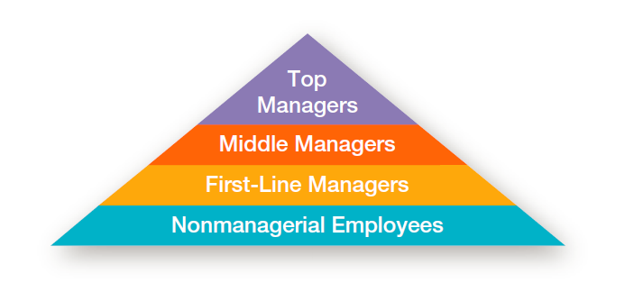
EXHIBIT 1-1 LEVELS OF MANAGEMENT

Slide 8
CLASSIFYING MANAGERS
First-line Managers - Individuals who manage the work of non-managerial employees. First-line managers may be called supervisors or even shift managers, district managers, department managers, or office managers.
Middle Managers - Individuals who manage the work of first-line managers. They may have titles such as regional manager, project leader, store manager, or division manager.
Top Managers - Individuals who are responsible for making organization-wide decisions and establishing plans and goals that affect the entire organization. These individuals typically have titles such as executive vice president, president, managing director, chief operating officer, or chief executive officer.

Slide 9


WHERE DO MANAGERS WORK?
Organization – A socially designed unit or collectivity that engages in a set of activities to accomplish a goal or objective, has an identifiable boundary and linked to the external environment

Slide 10
EXHIBIT 1-2 CHARACTERISTICS OF ORGANIZATIONS
Objectives
Identifiable Boundary
Socially Designed Unit or Collectivity
Linked to the External Environment
Deliberatively Designed and Coordinated Activities

Slide 11
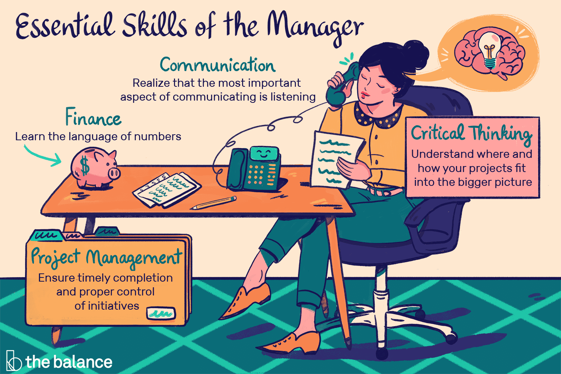
WHAT DO MANAGERS DO?
Management involves coordinating and overseeing the work activities of others so that their activities are completed efficiently and effectively.
Efficiency
“Doing things right”
Not wasting resources
Effectiveness
“Doing the right things”
Attaining organizational goals
Management researchers have developed three approaches to describe what managers do: functions, roles, and skills.

Slide 12
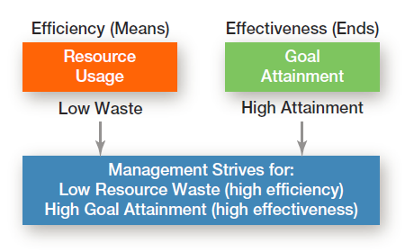
EXHIBIT 1-3 EFFICIENCY AND EFFECTIVENESS IN MANAGEMENT

Slide 13
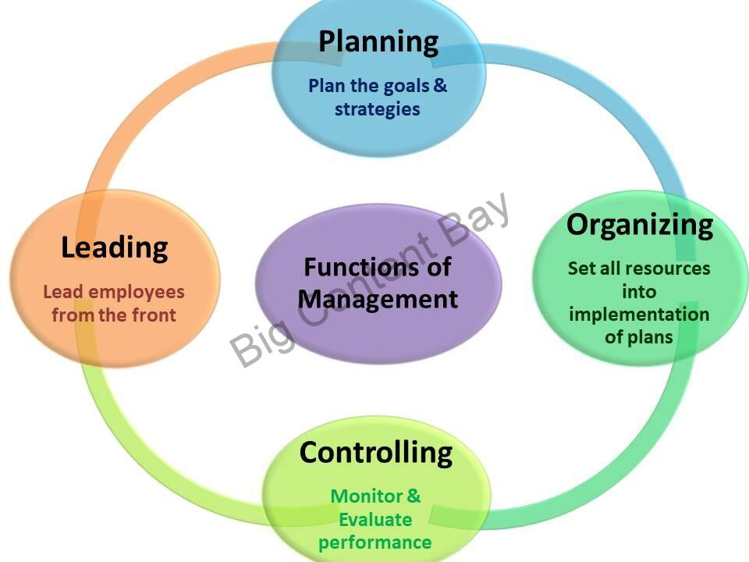
THE FOUR MANAGEMENT FUNCTIONS
Planning - Defining goals, establishing strategies to achieve goals, and developing plans to integrate and coordinate activities.
Organizing - Arranging and structuring work to accomplish organizational goals.
Leading - Working with and through people to accomplish goals.
Controlling - Monitoring, comparing, and correcting work.

Slide 14
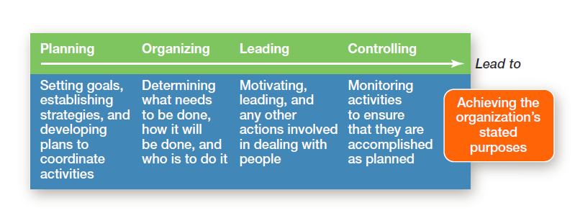
EXHIBIT 1-4 FOUR FUNCTIONS OF MANAGEMENT

Slide 15

MANAGEMENT ROLES
Roles are specific actions or behaviors expected of a manager.
Henry Mintzberg identified 10 roles grouped around interpersonal relationships, the transfer of information, and decision making.

Slide 16
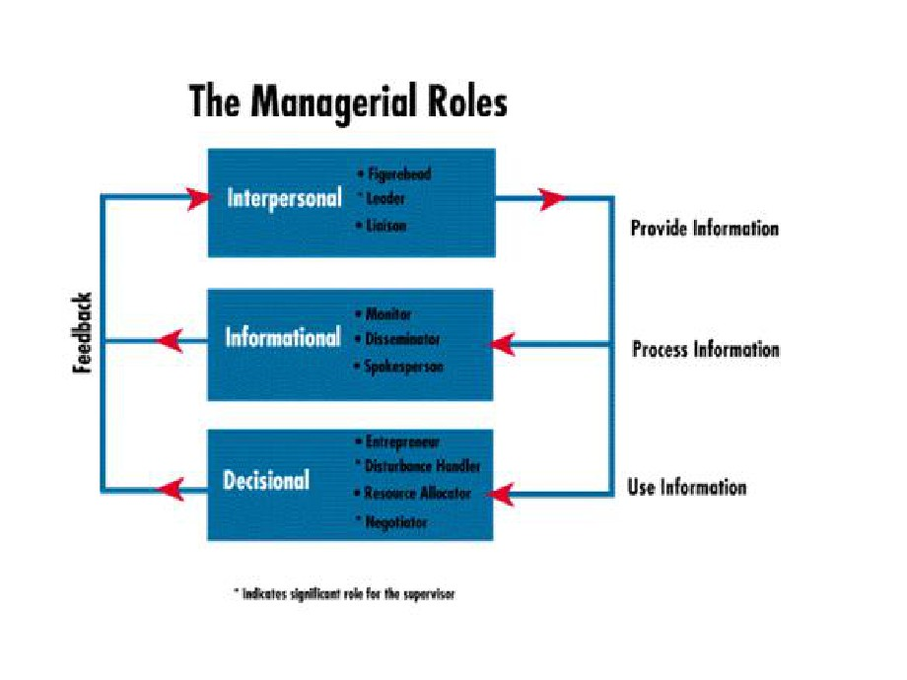
THREE TYPES OF ROLES
Interpersonal roles
Figurehead, leader, liaison
Informational roles
Monitor, disseminator, spokesperson
Decisional roles
Entrepreneur, disturbance handler, resource allocator, negotiator

Slide 17
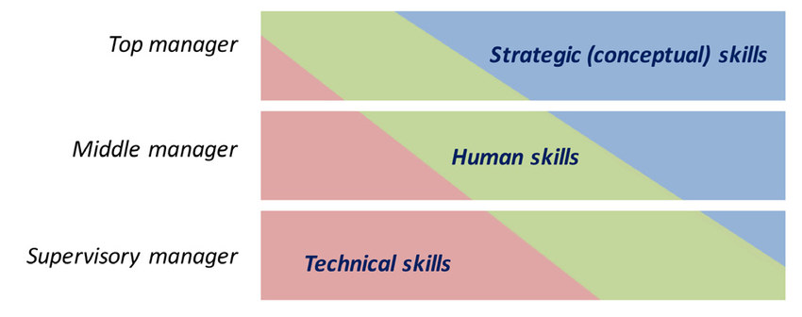
SKILLS MANAGERS NEED
Robert L. Kartz proposed that managers need 3 skills:
Technical skills
Knowledge and proficiency in a specific field
Human skills
The ability to work well with other people
Conceptual skills
The ability to think and conceptualize about abstract and complex situations concerning the organization

Slide 18
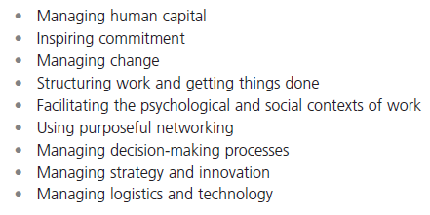
EXHIBIT 1-7 OTHER IMPORTANT MANAGERIAL SKILLS

Slide 19
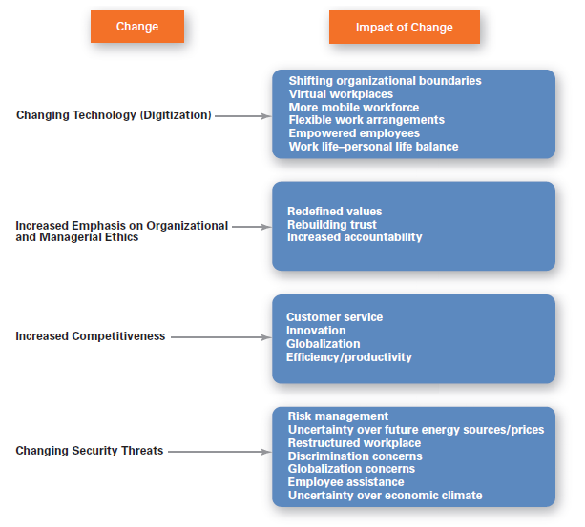
EXHIBIT 1-8 CHANGES FACING MANAGERS

Slide 20


THE IMPORTANCE OF CUSTOMERS
Customers: the reason that organizations exist
Managing customer relationships is the responsibility of all managers and employees.
Consistent high quality customer service is essential for survival.

Slide 21


IMPORTANCE OF SOCIAL MEDIA
Social media
Forms of electronic communication through which users create online communities to share ideas, information, personal messages, and other content

Slide 22


THE IMPORTANCE OF INNOVATION
Innovation
Doing things differently, exploring new territory, and taking risks.
Managers should encourage employees to be aware of and act on opportunities for innovation.

Slide 23


THE IMPORTANCE OF SUSTAINABILITY
Sustainability -
a company’s ability to achieve its business goals and increase long-term shareholder value by integrating economic, environmental, and social opportunities into its business strategies.

Slide 24


WHY STUDY MANAGEMENT?
Universality of Management
The reality that management is needed
in all types and sizes of organizations
at all organizational levels
in all organizational areas
in all organizations, regardless of location

Slide 25
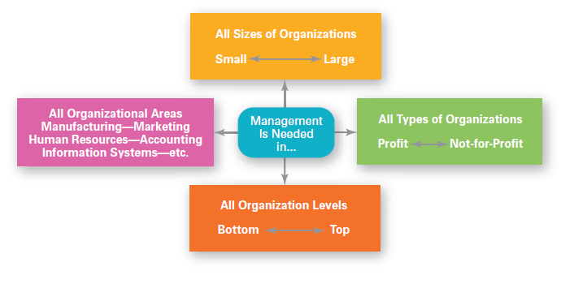
EXHIBIT 1-9 UNIVERSAL NEED FOR MANAGEMENT

Slide 26
WHY STUDY MANAGEMENT?
A person will either manage or be managed.
The awareness of the significant rewards and challenges

Slide 27


CHALLENGES OF BEING A MANAGER
Challenges
Can be a thankless job
May entail clerical type duties
Managers also spend significant amounts of time in meetings and dealing with interruptions
Managers often have to deal with a variety of personalities and have to make do with limited resources

Slide 28


REWARDS OF BEING A MANAGER
Rewards
Responsible for creating a productive work environment
Recognition and status in your organization and in the community
Attractive compensation in the form of salaries, bonuses, and stock options

Slide 29
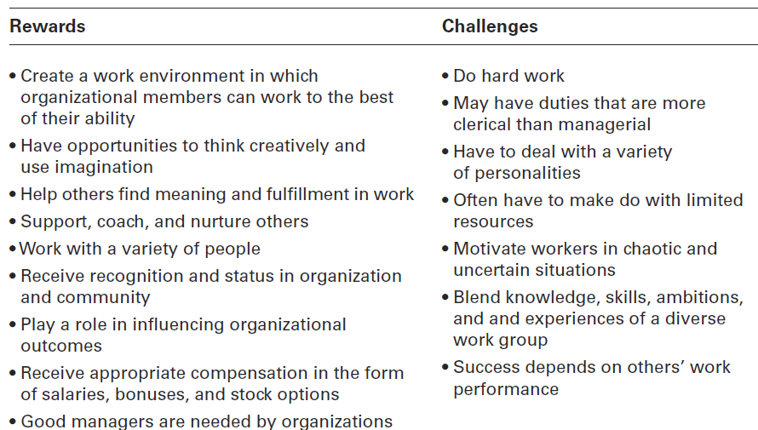
EXHIBIT 1-10 REWARDS AND CHALLENGES OF BEING A MANAGER

Slide 30

ANY QUESTION?

